Slide 1

RETAIL SALES
Retail is a customer business. You're trying to take care of the customer.
TEAM C
RAMYA R
SANDHIYA M
SANGEETHA S
SHIBIKANTH R

Slide 2
OBJECTIVE
The objective of our project is to analyze a list of 7,000+ electronic products given with pricing information.
Our Retail Sales data has been used to identify retail industry trends in pricing strategies
Our project can pursue goals related to one or more of these areas like sales, suggestions, quality, profit and satisfaction of publics through reviews.

Slide 3
ARCHITECTURE
Data Source
CSV
Data Processing External table on
Data Storage
Spark
MySql
PySpark
Grafana
Visualization Tool

Slide 4
TECHNICAL SPECIFICATION
Data sources: CSV files
Data storage: PySpark
File formats: CSV
Data ingestion: Spark shell
Data cleansing and scrubbing : Spark, Mysql
Data computation and Analysis: Mysql, ML
ETL: Spark, Pandas, Mysql
Visualization : Grafana
Language : Python

Slide 5
INGESTION AND PREPARATION OF WORKFLOW 1 & 2
Load the CSV file to local using wget command
Started with PySpark and read the CSV file using PySpark
Data frame created in pyspark
Cleansing, Scrubbing and removing unwanted records from the table.
Dropping columns with null values.
Performing Sort operation in retail sales file.
Applying possible Transformation on data frames
Performing partition of particular column.
Implementing Py spark data frame to Mysql and performing operations.
Integration from Mysql to Grafana.

Slide 6


WORKFLOW 1
T
R
A
N
S
F
O
R
M
A
T
I
O
N
LOAD
LOCAL
READ

Slide 7
TRANSFORMATIONS ON DATAFRAMES
Spark Transformation is a function that produces new RDD from the existing RDDs.
We used "sort" function to sort the brand column.
To get the details of Sold/Unsold product, Brand, Merchant and Selling Status we applied ‘filter’ method.
We applied "GroupBy" to count the merchant selling status for a particular brand.
Using ‘agg’ to find the Mean of Max and Min amount sold by overall merchants.

Slide 8





WORKFLOW 2

Slide 9
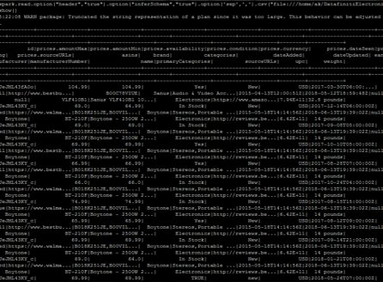
To read CSV file into spark
DatafinitiElectronicsProductsPricingData.csv

Slide 10
Business queries
QUERY 1: What is the pricing strategy for the products from its sales price(Max & Min)
Pricing strategies account for many of your business factors, like revenue goals, marketing objectives, target audience, brand positioning, and product attributes.
we have inferred that the average of minimum price column as 463, and average of maximum price column as 494 through this analysis the average selling price (ASP) is determined which refers to the average price of a good or service is sold for. The total revenue earned by the particular categories can be inferred.
QUERY 2: What is the competitive pricing strategy for the same product from different merchants
According to the calculations and analysis made , minor variations in prices can lower or raise profit margins by more than 20-25%.From the analysis for this query we inferred that the two competing merchants, manufactures the same brand & both will try to keep their prices in line with each other and advertise their product to stand out in quality and features, to compete with the other brand. The sale price for both the competitor was in 10% difference

Slide 11
QUERY 3: Count Which brands product are on sale in the market
Companies and Product With Outstanding Brand Equity makes the products to reach the highest count in the market.
As a result, we have observed that out of 7249 products in the market 1740 products are in sale and 5506 products are not in sale.
We have also inferred that the products which was in sales was high on the year 2015 during the month of december as it is the peak time to buy the products in the vacation.
QUERY 4: Count of sold/unsold products during the particular years the sales updated more/less
In those years, a total of 7249 products were on demand in the market.
In that total products the number of products were in sale was 1740 and 5506 was already sold or may be not in sale.

Slide 12

QUERY 5: Whether New or Used product sales are High/Low
We found that selling new products requires greater intensity and consumes much more attention than the used products. On average, sales people spend 35% more time meeting with customers throughout the sales cycle than they do when selling established goods and services.

Slide 13
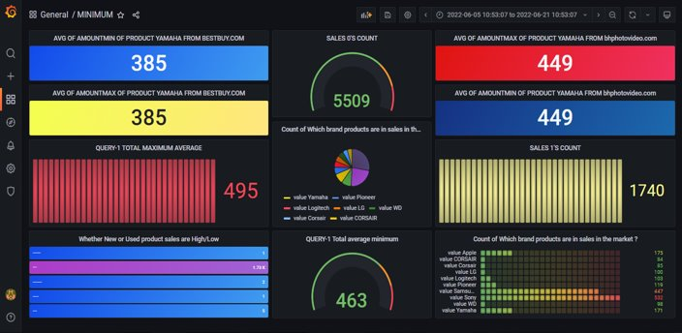
DATA VISUALIZATION

Slide 14

Thank you

